Slide 1

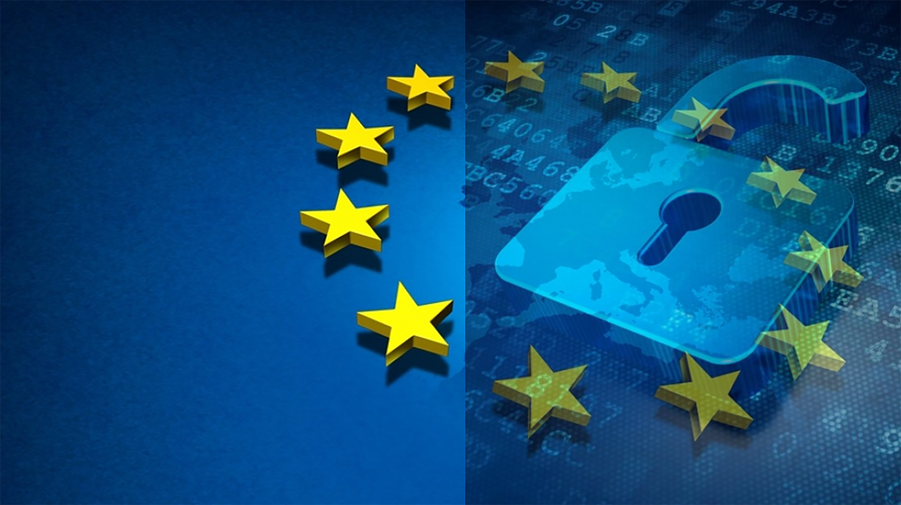
Microsoft GDPR Detailed Assessment – v3.0 Oct 2018
How to deliver
<your name>
This presentation is intended to provide an overview of the Microsoft GDPR Detailed Assessment and is not a definitive statement of the law.

Slide 2
Version History & Updates
hidden slide
V | Date | Who | What
0.1 | 13-09-2017 | François van Hemert | First Draft
0.2 | 18-09-2017 | David Bjurman-Birr | Review
1.9 | 18-09-2017 | François van Hemert | Submitted for CELA review
2.0 | 04-10-2017 | François van Hemert | Published version
2.1 | 06-12-2017 | François van Hemert | Replaced toolkit with Toolkit
3.0 | 29-03-2018 | François van Hemert | Added Compliance Manager integration
Please keep this page up to date!
Notes:
This deck is frequently updated with new insights and feedback from the field. Please keep version history up to date.

Slide 3
Intended usage
This model is a question-driven assessment tool for preparing for the General Data Protection Regulation (GDPR) (Regulation (EU) 2016/679). The tool is intended to be used by Microsoft partners to assist customers in identifying where they are on the journey to GDPR readiness. Output from the tool includes identification of gaps in customer readiness and recommendations to consider for closing any gaps. Recommendations are organized into the categories People, Process and Technology.
Disclaimer
This GDPR Detailed Assessment is intended to assist organizations with assessing their GDPR compliance progress. This GDPR Detailed Assessment is provided for general public informational purposes only. Any results, scoring or recommendations produced by the GDPR Detailed Assessment should not be relied upon to determine how GDPR applies to an organization or an organization’s compliance with GDPR, and they do not constitute legal advice, certifications or guarantees regarding GDPR compliance. Instead, we hope the GDPR Detailed Assessment identifies technologies and additional steps that organizations can implement to simplify their GDPR compliance efforts. The application of GDPR is highly fact-specific. We encourage all organizations using this GDPR Detailed Assessment to work with a legally qualified professional to discuss GDPR, how it applies specifically to their organization, and how best to ensure compliance.
MICROSOFT MAKES NO WARRANTIES, EXPRESS, IMPLIED, OR STATUTORY, AS TO THE INFORMATION IN THIS GDPR DETAILED ASSESSMENT. Microsoft disclaims any conditions, express or implied, or other terms that use of the Microsoft products or services will ensure the organization’s compliance with the GDPR. This GDPR Detailed Assessment is provided “as-is.” Information and recommendations expressed in this GDPR Detailed Assessment may change without notice.
This GDPR Detailed Assessment does not provide the user with any legal rights to any intellectual property in any Microsoft product or service. Use of the tool is for internal, reference purposes only; however, Microsoft partners may distribute the GDPR Detailed Assessment to their customers for such customers’ internal, reference purposes only. Any distribution of the GDPR Detailed Assessment by a Microsoft partner to its customers must include terms consistent with those set forth in this disclaimer.
© 2017 Microsoft. All rights reserved
Notes:
Discuss the disclaimer and its intention with your customer. It is important to emphasize the information contained in the disclaimer.

Slide 4
Agenda
What is the Microsoft GDPR detailed assessment?
1
The Toolkit
2
Engagement overview
3
Tips & Tricks
4

Slide 5
What is the Microsoft GDPR Detailed Assessment?
A tool that partners can use to help customers assess the maturity of their people, processes, and technology, relevant to the GDPR.
A tool that provides visuals and recommendations to guide customers to appropriate solutions, enabling customers to elevate their GDPR maturity.
Important
The Microsoft GDPR Detailed Assessment is NOT a tool to certify compliance.
It is the distributed responsibility of the customer and their legal and compliance teams to certify their own GDPR compliance.
Notes:
Highlight the goal of the assessment:
It is important to emphasize that this tool is the first step towards GDPR compliance and it will help to find out where the customer is at this moment in time.
It will generate valuable input that helps reveal challenges the organization has.
It is not about Microsoft products, its about understanding the customers situation and providing them with advice and recommendation that can help them on their journey to GDPR compliance
Emphasize that this assessment will not in anyway certify compliance or provide a compliancy statement.

Slide 6
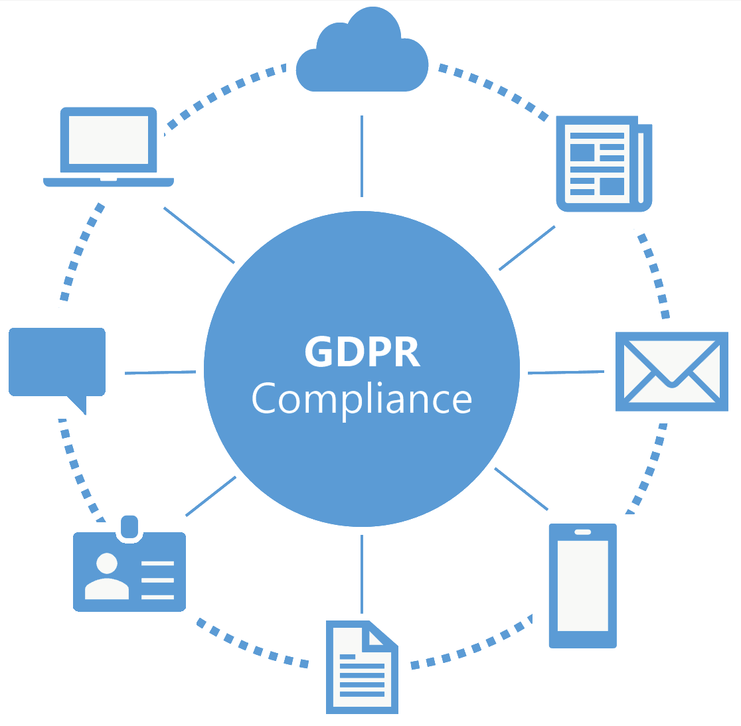

Assessment opportunities
Identify GDPR compliance gaps
Identify maturity along key GDPR scenarios
Identify potential data security and compliance challenges
Determine the current state of personal data security.
Notes:
The journey to GDPR compliance starts with understanding the maturity of people, processes and technology at the customer .
The Microsoft GDPR detailed Assessment is focused on this.
It is important to understand that the assessment will not access (personal) data or analyze it, the assessment will look at the people, process and technology the customer uses to work with (personal) data.

Slide 7




Assessment objectives
Understand GDPR compliance objectives
Gain a common understanding of compliance objectives and GDPR requirements
Assess GDPR maturity level
Assess the organization’s preparedness to execute on Discover, Manage, Protect, & Report activities
Create a GDPR compliance roadmap
Provide a prioritized and actionable list of next steps and roadmap, ready for legal/advisory review
Notes:
Briefly explain the objectives for the assessment:
Understand what the customer wants and needs to become GDPR compliant
Assess the current maturity level, do they for example have processes in place to protect data or report on data breaches?
The outcome of the assessment will be a list of actionable items. Addressing these will help the customer on its journey to GDPR compliance
It is important that the outcome of the assessment and the actions defined are reviewed with a legal focus

Slide 8

Out of Scope
Technical designs or product implementations
Proof of concepts or labs
Recommendations for non-Microsoft technology
Notes:
If partner is providing recommendations for non-Microsoft technology, the slide should be updated.
All activities are focused on assessing maturity of people, process and technology with respect to the GDPR, during the assessments suggestions and activities will be defined to optimize existing or implement new processes and technology. Implementing these suggestions however is not part of this assessment.

Slide 9
Outcomes
From here to there
Where are you today?
Where do you want to go?
Where do you need to go?
How will you get there?
What does success mean to you?
Workshop Outcome
Know and understand GDPR maturity based on the Microsoft GDPR Detailed Assessment
Prioritized, actionable next steps and roadmap towards GDPR compliance
Notes:
The assessment is the start of the journey towards GDPR compliancy. It clearly charts the current situation and will outline actions that will assist in becoming GDPR compliant.

Slide 10
The Toolkit

Slide 11
Contents – what’s in the toolkit?
Delivery Guide
Detailed engagement overview
Describes preparation, activities timelines and materials to use
Presentation templates
Customer ready content to be used during the engagement
Customize and update with customer data before use
GDPR assessment tool
Questionnaire with 150+ questions that help assess GDPR maturity
Automated report template providing insight and recommendations
Notes:
The toolkit is downloadable from the partner website and contains all materials required for the GDPR Detailed Assessment

Slide 12
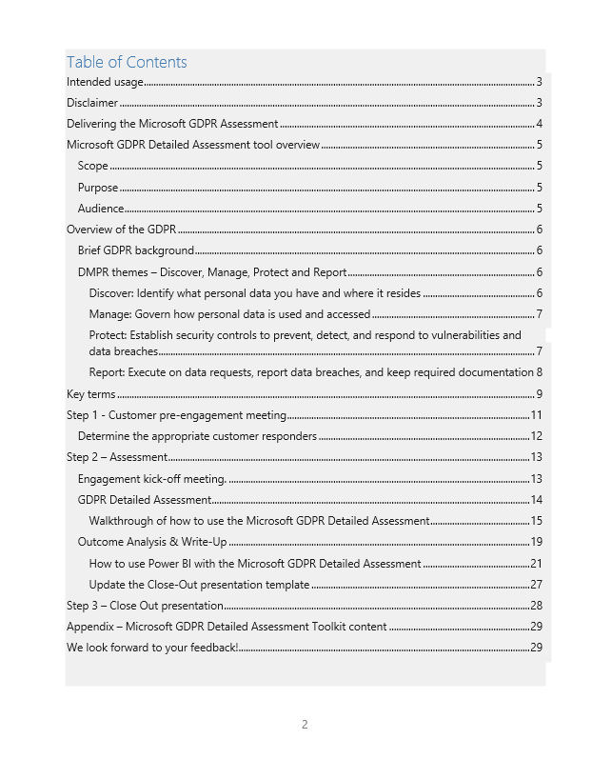
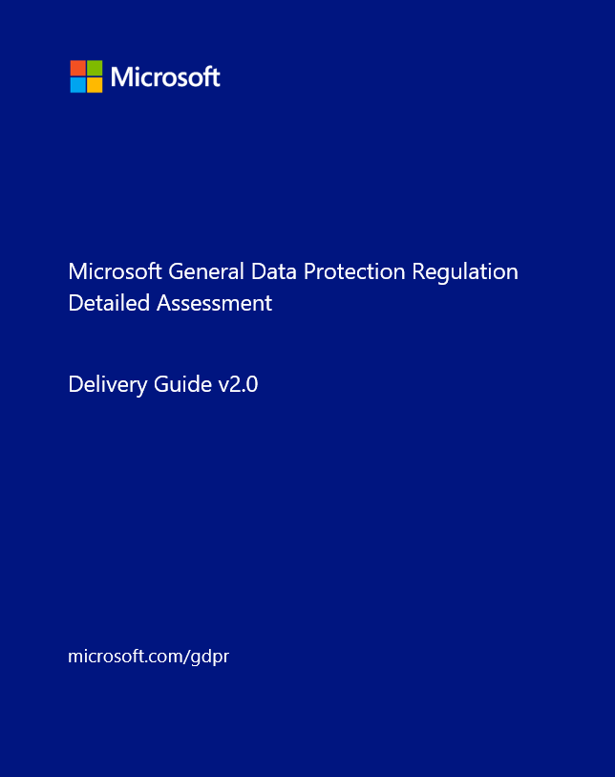
Delivery Guide
Start here!
Introduction to the assessment
Delivery guidance
Background on the GDPR
Microsoft’s approach towards GDPR compliance
3-Steps with clearly defined activities
Per activity
Description - what to do and why
Objectives - what is it we want to achieve?
Resources – what to use from the toolkit
Preparation – how to best prepare for delivery
Deliverables – expected outcome
Duration –Estimation of time per activity
Assessment tool
How to use the tool and how to create a report
Notes:
The Delivery guide is the goto document during the duration of the assessment, it provides detailed information about the activities and guidance how to use the different resources.

Slide 13
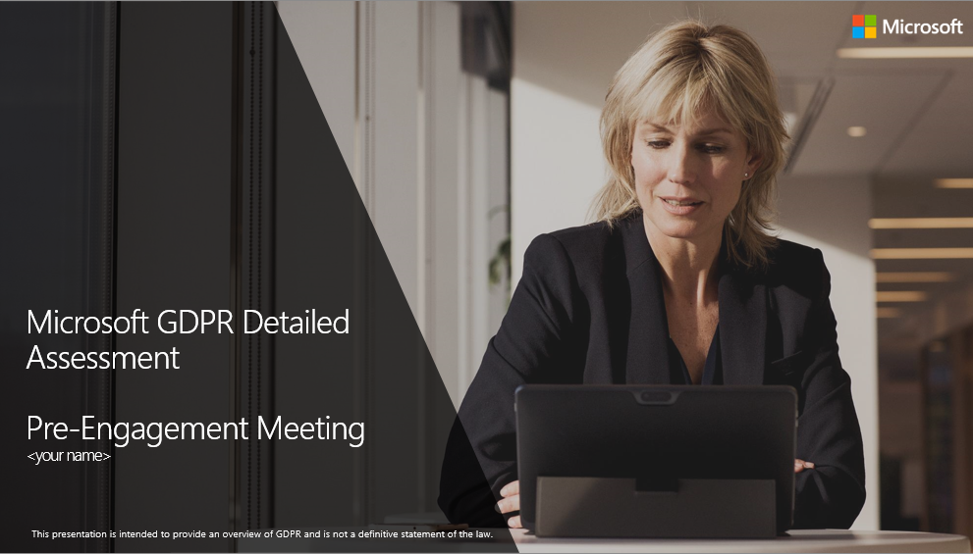
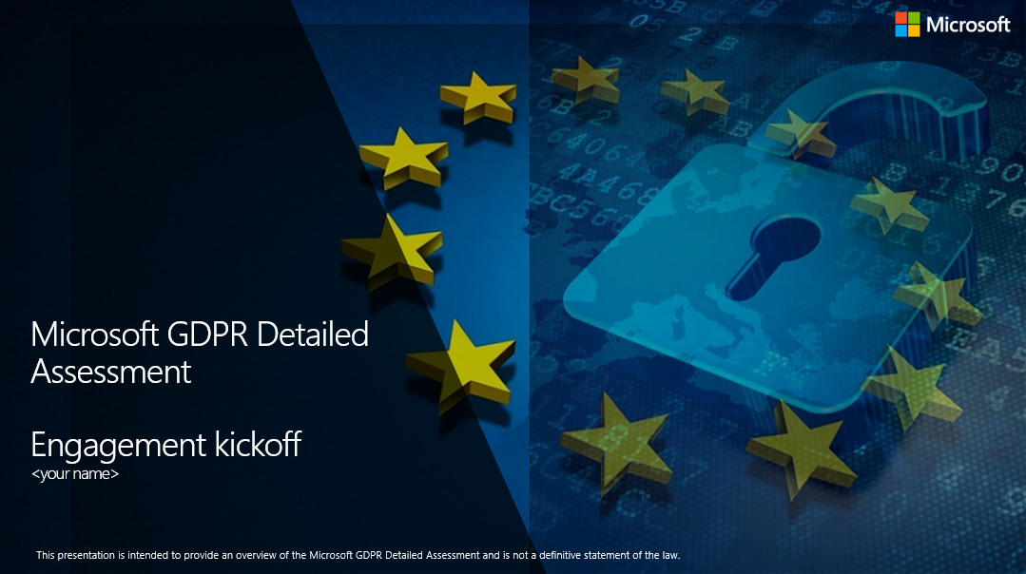
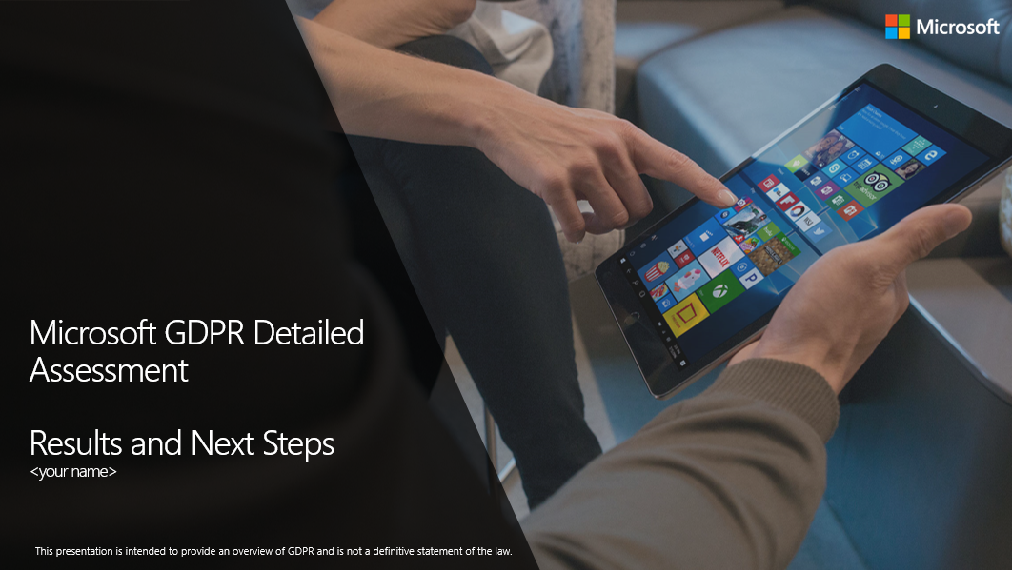
Presentation templates
Pre-engagement meeting template
Introduction to the Microsoft GDPR Detailed Assessment
To be used at the first on-line meeting
High-level information on the GDPR
Discuss time lines, allocate resources and align expectations
Kickoff meeting template
To be used at the on-site kickoff meeting
Information on the GDPR
Introduction to the assessment tool
Confirm time lines, resources and expectations
Close-out meeting template
Final presentation of findings
Recommendations and actionable next steps
Executive overview & detailed outcome

Slide 14
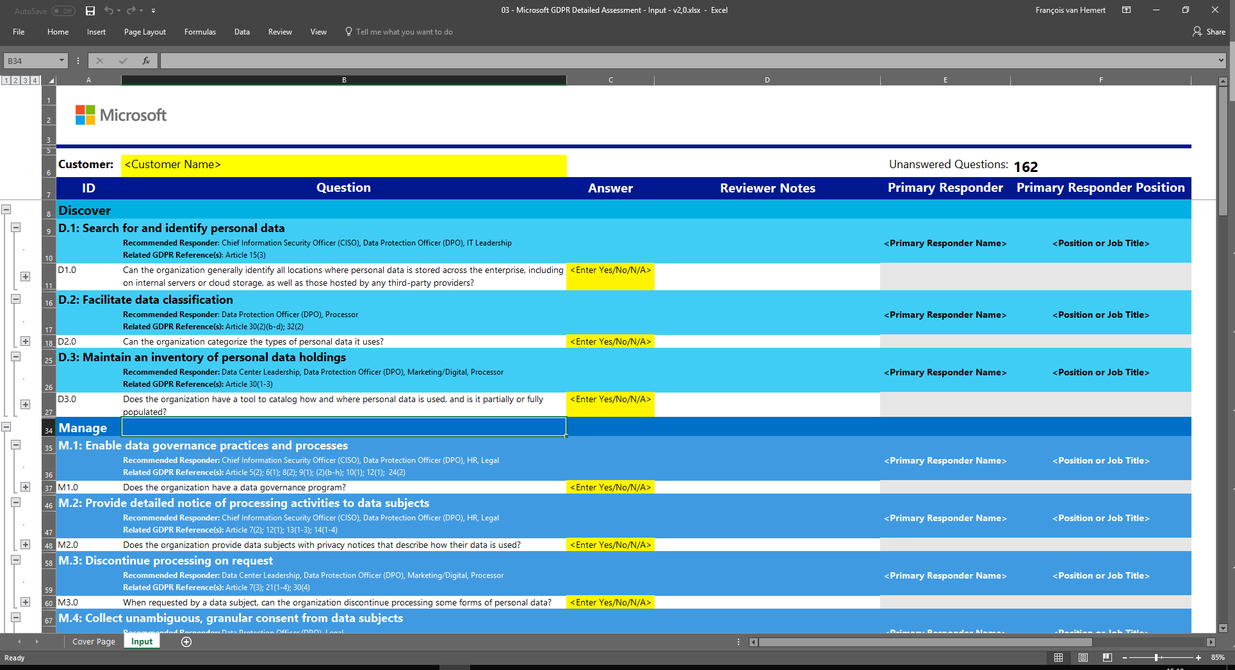
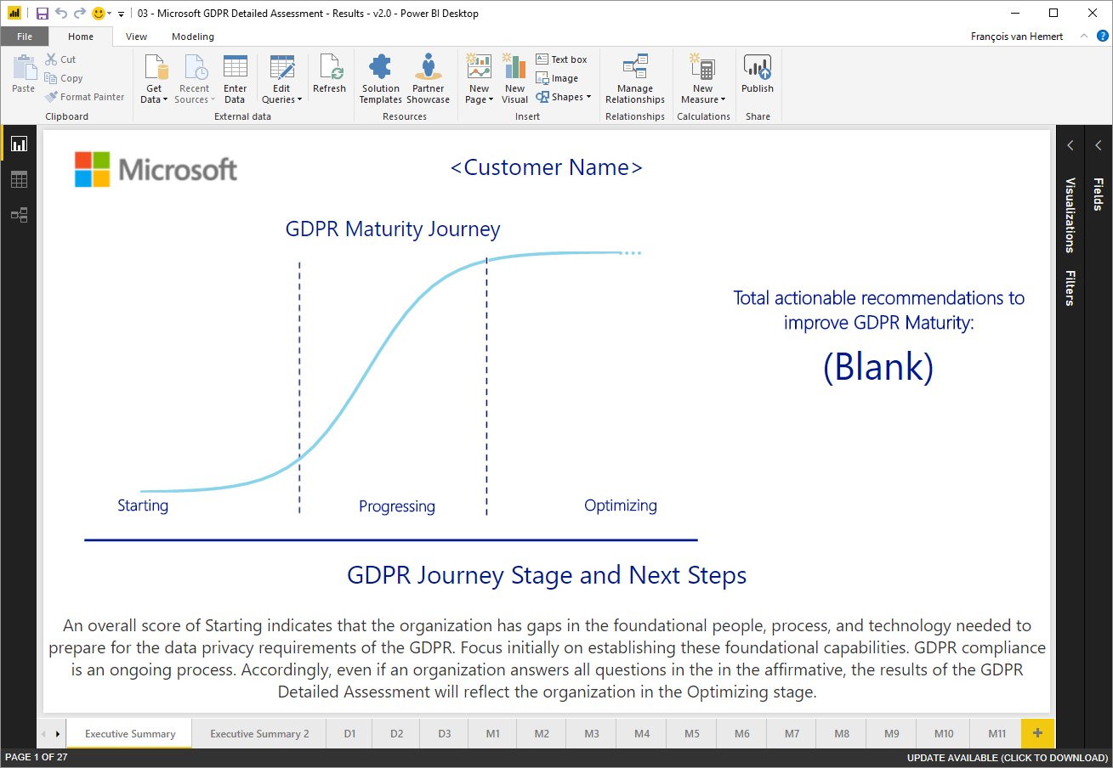
Assessment tool
Questionnaire
Microsoft Excel workbook
150+ Yes/No questions to assess GDPR maturity
Grouped by theme and sub-scenario’s (Discover, Manage, Protect and Report)
Reference to relevant GDPR articles
Report generator – output file
PowerBI output file linked to the questionnaire
Provides high-level visualization of organization’s GDPR maturity
Generates recommendations to improve maturity per theme

Slide 15
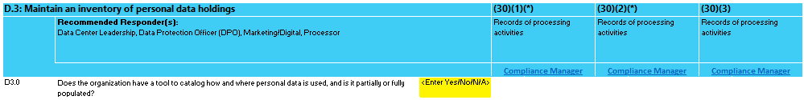
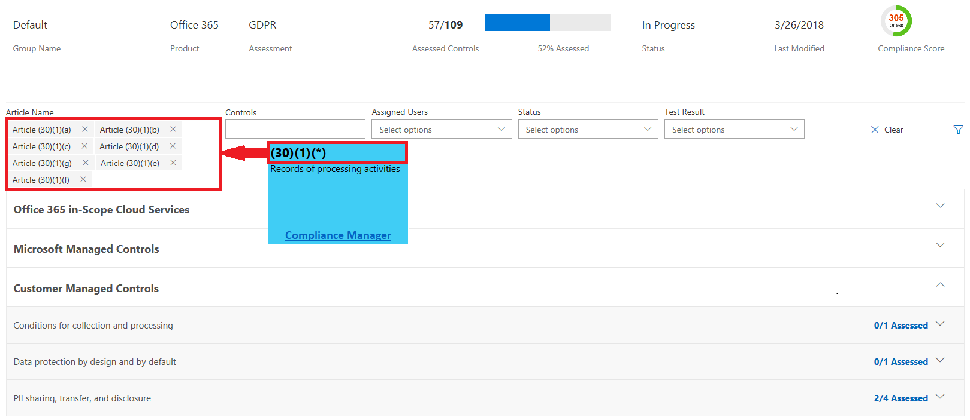
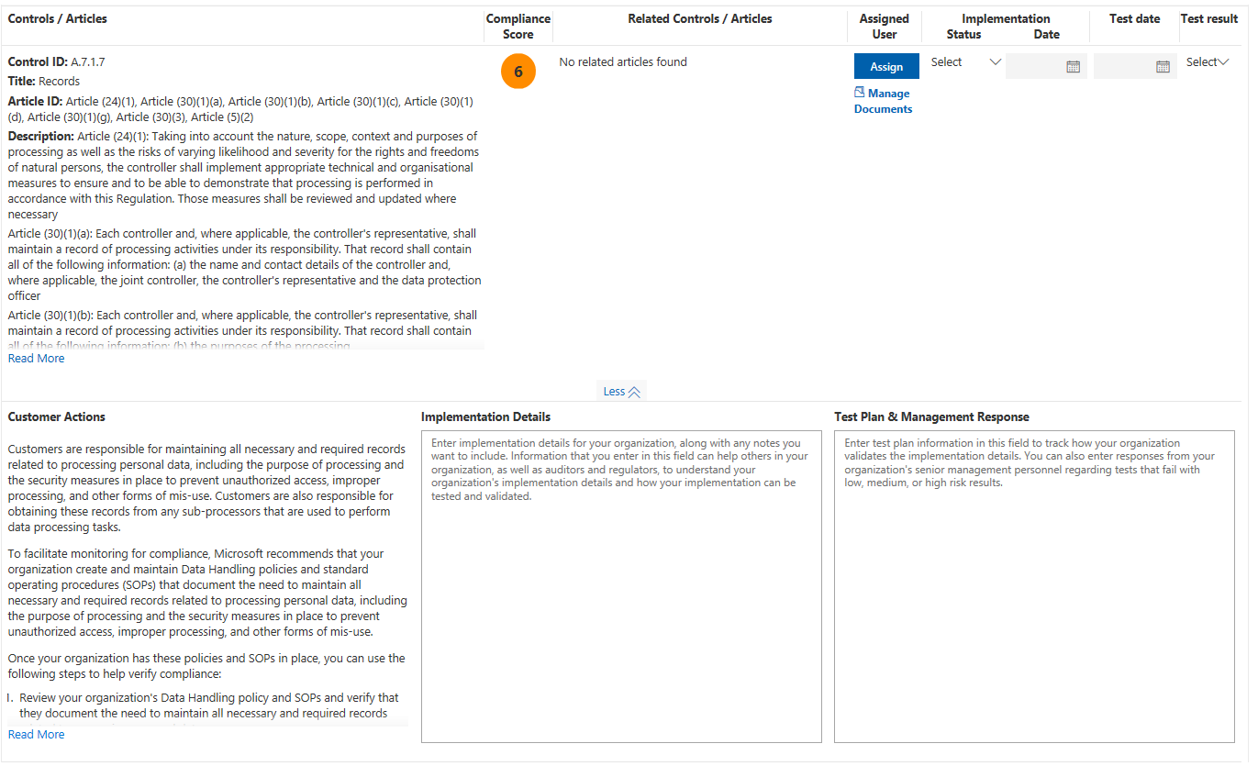
Compliance Manager integration
Optional activity
GDPR article references
Every sub-scenario provides statutory references to relevant GDPR articles
Per article links to relevant Compliance Manager controls
Compliance Manager
Real-time assessment of the GDPR compliance posture for customers assets in the Microsoft cloud
Actionable insights into both customer’s and Microsoft’s responsibility to meet compliance standards
Documented customer actions
Task delegation and assignment
Tracking and evidence gathering
Notes:
The GDPR Detailed assessment offers integration with Microsoft Compliance Manager.
For every sub-scenario under Discover, Manage, Protect and Report, the applicable GDPR articles are referenced.
For every article a link to compliance manager is provided that when clicked, will open a filtered view of the Compliance Manager dashboard. The dashboard will show both Microsoft and Customer controls that are relevant to the GDPR article referenced.
Note
Compliance manager requires a Microsoft cloud tenant. Preferably the customers production tenant is used.
Remove or hide slide if not used.

Slide 16
Demo
GDPR Detailed Assessment Tool with Compliance Manager integration
Notes:
Demo the use of the assessment tool by showing the questionnaire and the power BI report.
Things to discuss:
Excel Input file
Knock-out questions
Different themes (Discover, Manage, Protect and Report
The links to the GDPR articles
PowerBI report generator
How to update the data source
The different views that are generate
Discuss the 2 executive views and explain the different elements
Discuss 2 or 3 sample detailed reports
Optional – Compliance Manager integration
Demonstrate Compliance Manager integration by clicking on links from the Assessment tool
Explain Customer vs Microsoft controls
Explain compliance score
Discuss details of one or two customer controls:
Details on regulation
Required activities
Test plans & results
Assign activities and manage status

Slide 17
Engagement overview

Slide 18
3-step approach
Prepare to go on-site
Assess and Analyze
Present and advise
On-line meeting with key stakeholder
Introduce the engagement
Define the timelines
Identify the resources (responders)
Align expectations
On-site workshop
Short kick-off meeting to confirm expectations
Complete the questionnaire
Analysis and write-up of findings
On-site meeting
Presentation of findings
Define actionable next steps
Agree on roadmap
Notes:
The engagement is built around 3 steps:
Prepare to go on site, because customers need time to allocate resources / responders it is good to have a pre-engagement meeting. Use this meeting to provide a high level overview of what is about to happen and ask them to allocate people and location for the upcoming on-site workshop. There is no need to go on-site, this can be done in a on-line fashion
Asses and Analyze, in this step we do the assessment, analyze the results and build the end-presentation. It is typically done on-site.
Present and advise, the final and most important part of the assessment. This is where you present the findings and provide recommendations. Make sure you define actionable and achievable next steps and plot them on a roadmap. Try to get commitment for the first step.
Optional activity for Step 2
The GDPR Detailed assessment offers integration with Microsoft Compliance Manager.
Compliance manager requires a Microsoft cloud tenant. Preferably the customers production tenant is used.
As an optional activity it is possible to assess the customers compliance posture for the Microsoft Cloud Tenants by using Compliance Manager

Slide 19
Timelines, duration and effort
Total effort
Pre-engagement meeting 2 hrs.
On-site assessment + write up 8 hrs.
Final presentation 2 hrs. +
Total 12 hrs.
Important
Effort & duration may vary depending on the complexity of the customers environment and the maturity of the organization
Estimated duration 2-3 weeks
1-2 hrs.
1 day
1-2 hrs.
Engagement start
Pre-Engagement meeting
Customer preparation
Secure executive sponsor and align resources to complete the Microsoft GDPR Detailed Assessment
On-site assessment
Complete the Microsoft GDPR Detailed Assessment,
analyze results and prepare recommendations
Present & Recommend
Present the findings, discuss remediation and next steps. Deliver prioritized roadmap
Notes:
The time line provided is indicative and needs to be tailored to customers requirements and availability.
The pre-engagement meeting is there to set things in motion and to start the process of identifying the right people and take care of logistics. The customer usually needs a week to do so
The actual on-site engagement will start one to two weeks after the online pre-engagement meeting and will take an average of 1-2 on site days.
After completion a close out meeting will be conducted in which the outcome of the assessment will be presented.
Note
These time lines do not include the assessment of the compliance posture for Microsoft Cloud Tenants.
Additional effort should be added, refer to the delivery guide for guidance

Slide 20
Tips and Tricks

Slide 21
Do’s and Don'ts
☑
☒
Do
Carefully select the audience and responders
Be customer specific, it is about how the GDPR impacts them
Translate the GDPR into their language and provide scenario’s that apply to them
Realize that technology and automation is not always the right answer
Help, educate and add value to the GDPR discussion
Become the trusted advisor
Define actionable and achievable next steps
Define a roadmap with a realistic timeline
Do Not
Over emphasize the penalties
Turn the assessment into a product show
Provide unqualified advice
Frame Microsoft 365 as the “magic bullet”
Make unsubstantiated compliance promises or guarantees
Send the questionnaire to the customer before the workshop
Execute the assessment (step 2) remotely via an on-line meeting
Notes:
Do
Carefully select the audience and responders, its important to have the right people in the room. The delivery guide and presentation decks provide guidance. Make sure you have Business Decisions Makers and Senior Management in the room when you present your findings.
Be customer specific, it is about how the GDPR impacts them, you will get the best results from the meeting if you can be customer specific and provide examples and scenario’s they recognize.
Translate the GDPR into their language and provide scenario’s that apply to them, legalese is often unappealing to customers, be the translator!
Realize that technology and automation is not always the right answer, some times a manual process can do the job. Its about what is best for the customer in his given situation. Technology might be overkill is you expect one request “to be forgotten” per year.
Help, educate and add value to the GDPR discussion, use the questions in the assessment as a starting point for a interesting discussion that adds value and helps the customer to understand GDPR. Each question can be a starter for an interesting conversation
Become the trusted advisor, listen and provide valuable answers, do not guess or assume. In this way you will learn about your customer and maybe become a person they trust and listen to.
Define actionable and achievable next steps, time is short, the customer needs to take action so try to prioritize next steps that the customer can commit to. It is often better to achieve one high priority task than get stuck discussing too many.
Define a roadmap with a realistic timeline, most likely there is a lot to do and not enough resources, time or budget. Start with the low hanging fruit that can be implemented on short time and generates the most results.
Do Not
Talk about penalties and threats, scaring your customer will often not work; however, providing a solution and helping them will
Turn the assessment into a product show, simply highlighting products to early may lose creditability. GDPR is not about products and in many cases customer don’t need to purchase to comply; however, the Microsoft cloud may make compliance simpler and easier.
“Talk Legal”, legal talk mostly is not appealing to customers, try to avoid it and be the translator
Present the magic bullet (there is no such thing), to become compliant the customer will most likely have to do a lot of activities. There is probably no single product or tool that accomplishes everything they need
Make promises or guarantees about compliance unless you are legally qualified to do so. Usually, you will be helping them on their journey towards compliance, its up to their legal team to assess and provide a compliance statement.
Send the questionnaire to the customer before the workshop, if you do you will likely lose the momentum to provide value and have in depth discussions. The pre-engagement meeting has some high level screen shots. Use them instead
Execute the assessment (step 2) remote using an on-line meeting, you want the interaction and lively discussions. This is often difficult to achieve in a online meeting. Have a face to face discussion instead!

Slide 22
Q&A

